Slide 1
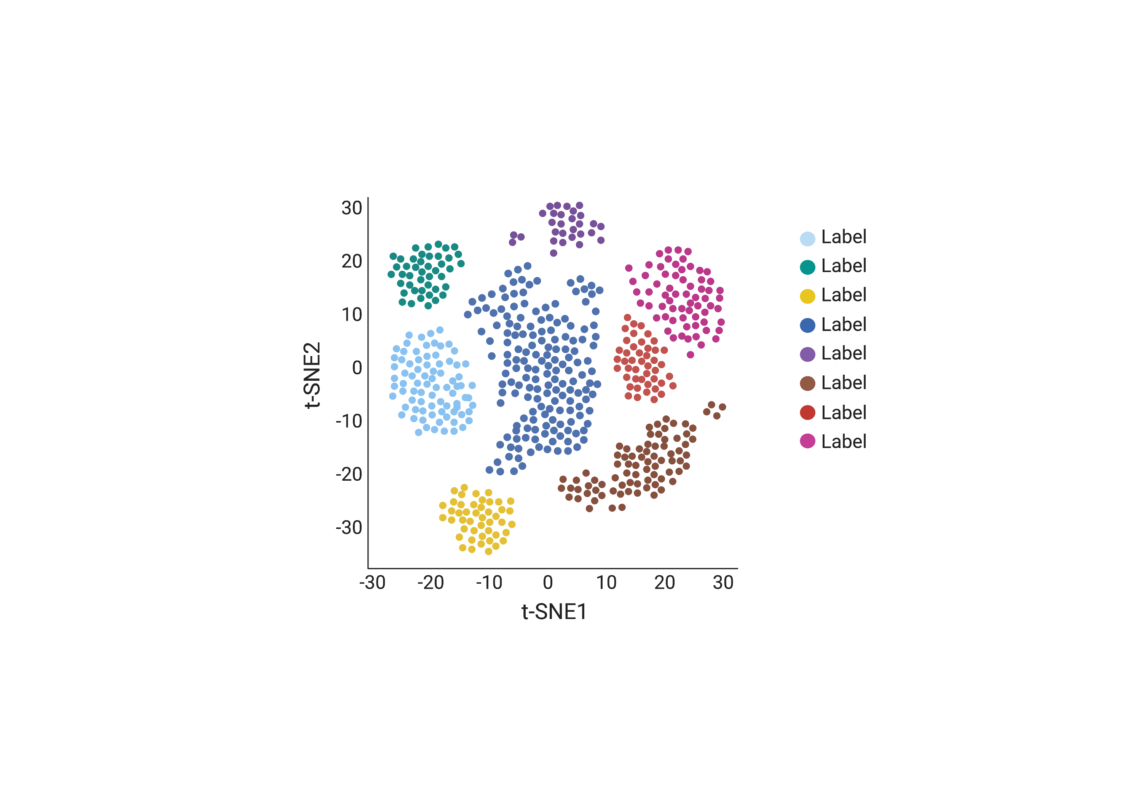
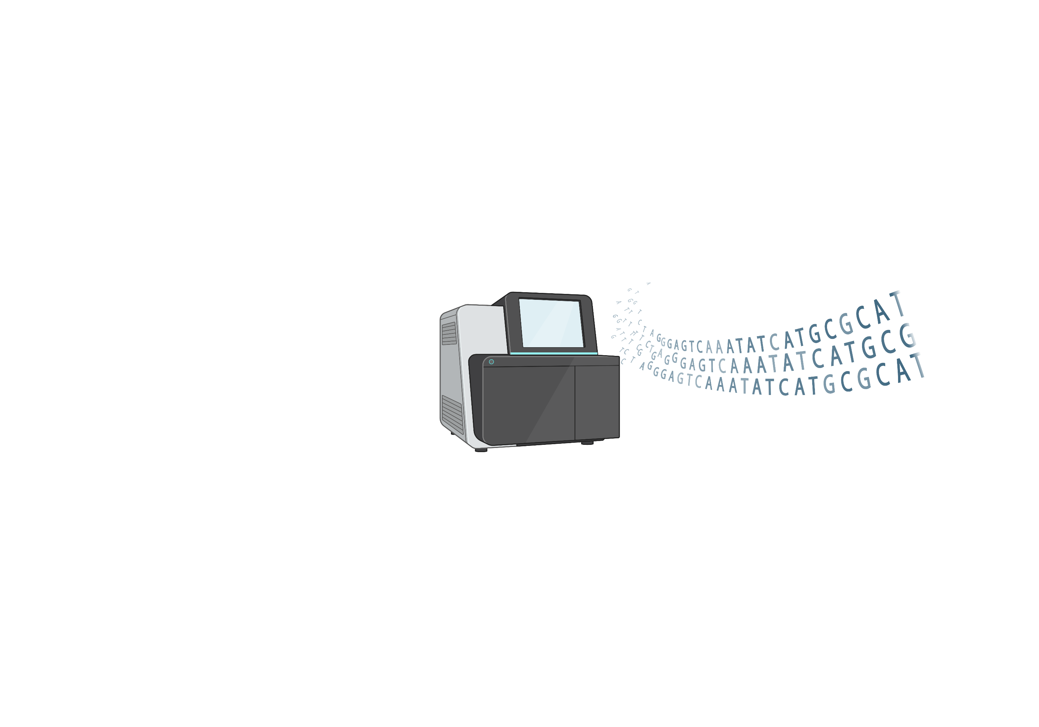
Introduction to Experimental Sequencing Methods
HCA Africa: Introduction to Single-Cell RNA-Seq Analysis Workshop
October 17, 2022
Daniela Russo

Slide 2
Overall Goals
Introduction to the rapidly expanding world of single-cell transcriptomics
Focus less on specific tools but more on underlying concepts - so down the line, you can make informed choices
Hands on lab exercises analyzing single-cell heterogeneity
Create a fun, learning, collaborative, and interactive environment over the next week

Slide 3
Course expectations
Raise hand in Zoom to ask question or put them in the chat
If not asking a question, please keep yourself muted
If we run out of time, or you have questions afterwards, use Slack
Please be patient with technical issues (network, Zoom, etc…)

Slide 4

Slack
https://slack.com/downloads

Slide 5
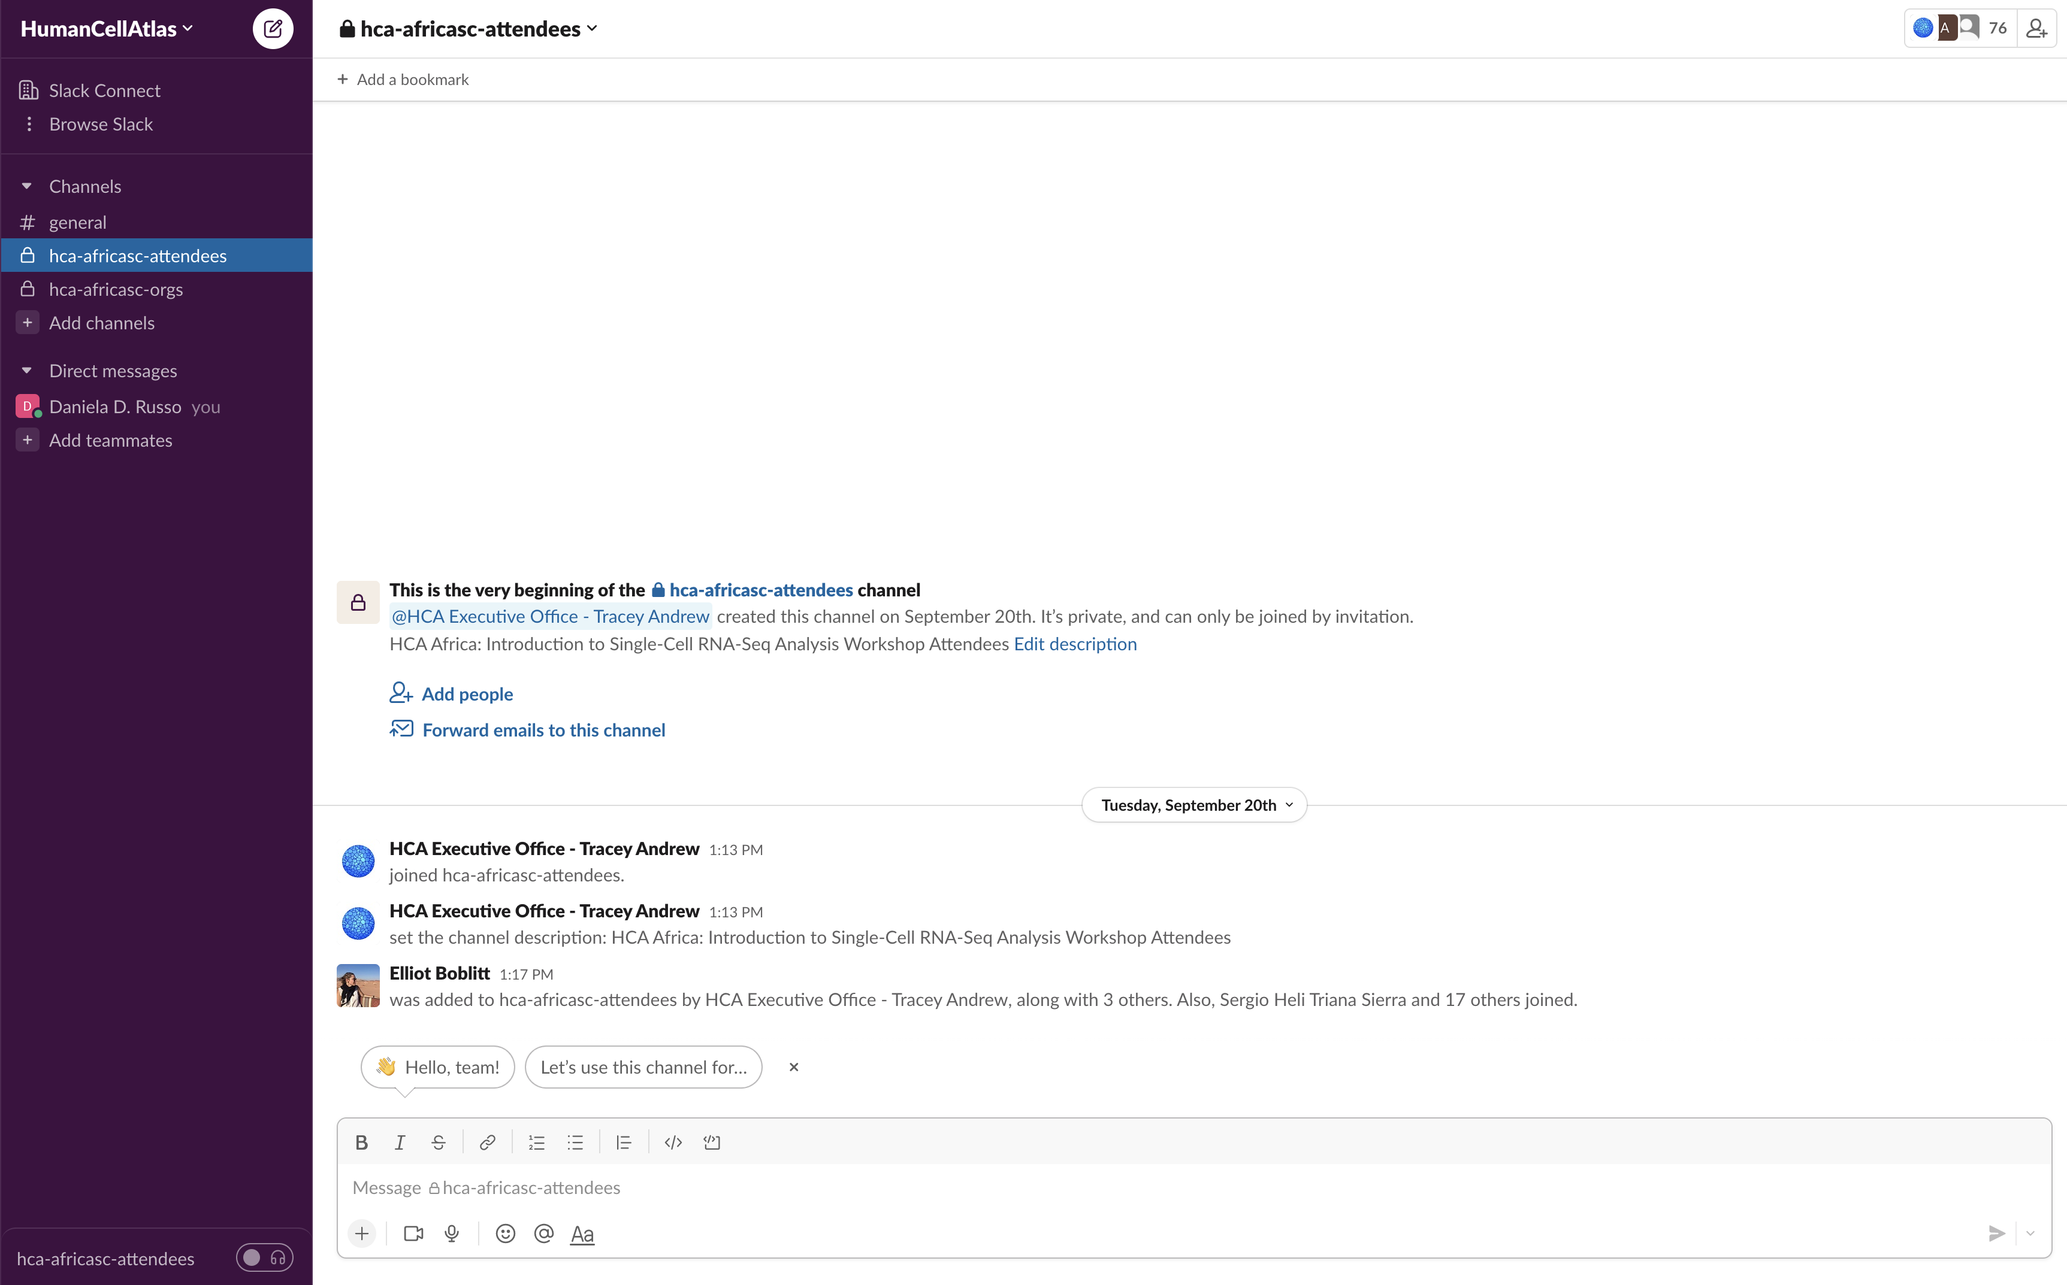
Slack

Slide 6
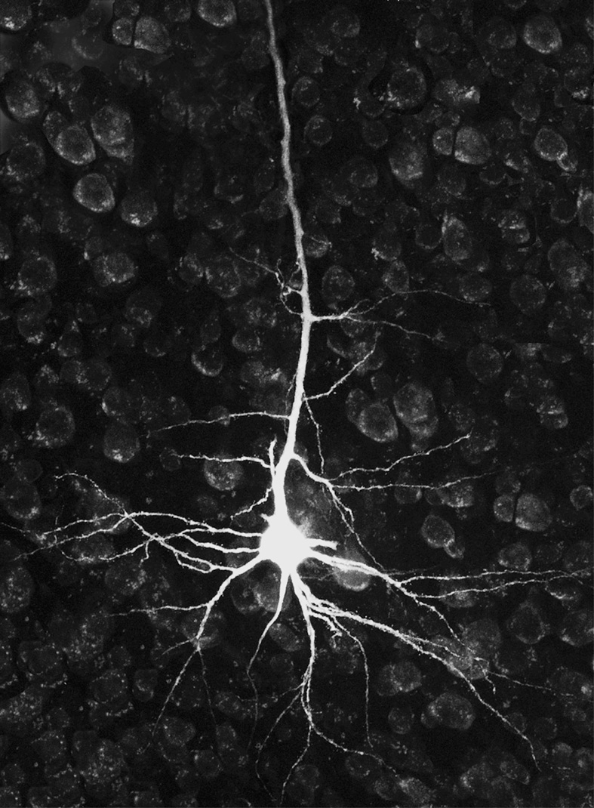
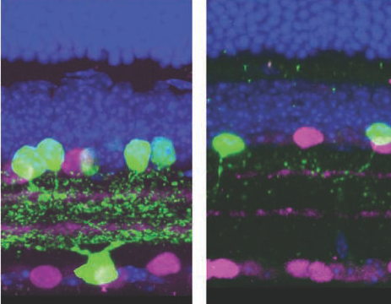
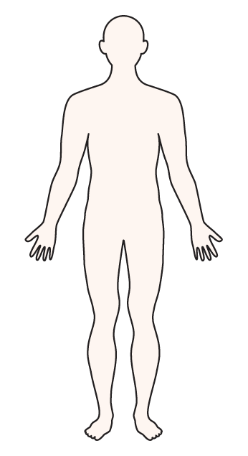
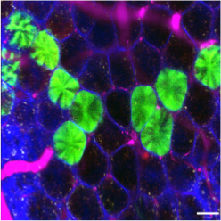
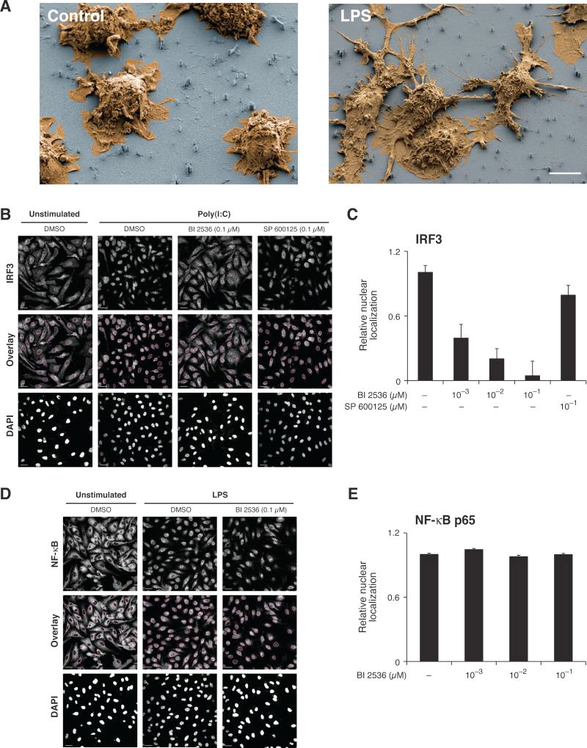
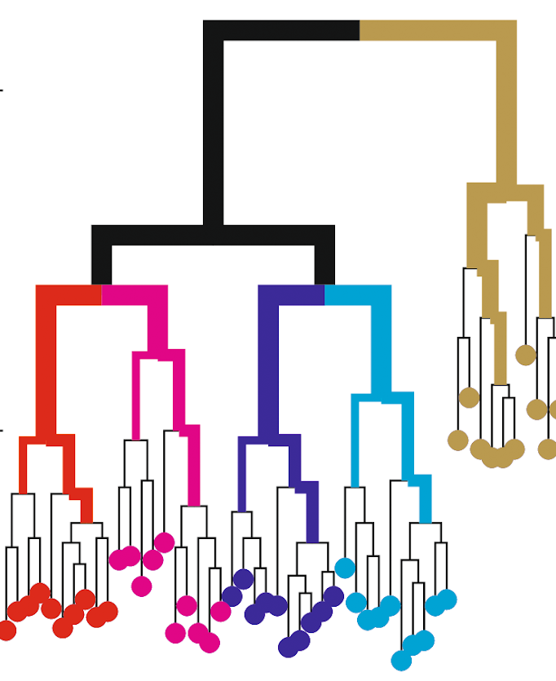
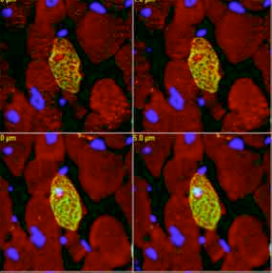
A cell’s identity and fate are shaped by many features
LOCATION
TYPE
INTERACTIONS
STATE
LINEAGE
TRANSITIONS
Notes:
Cell is fundamental unit of tissue, and diversity of tissues driven by many different cellular features. Basic feature is type: hematopoietic stem cell or T cell. Using T cell as example, is T cell circulating in blood stream, or is at a germinal center interacting with a B cell. Is T cell naïve (not seen antigen) or memory? What are cell divisions and transcriptional changes leading from HSC to T cell?

Slide 7
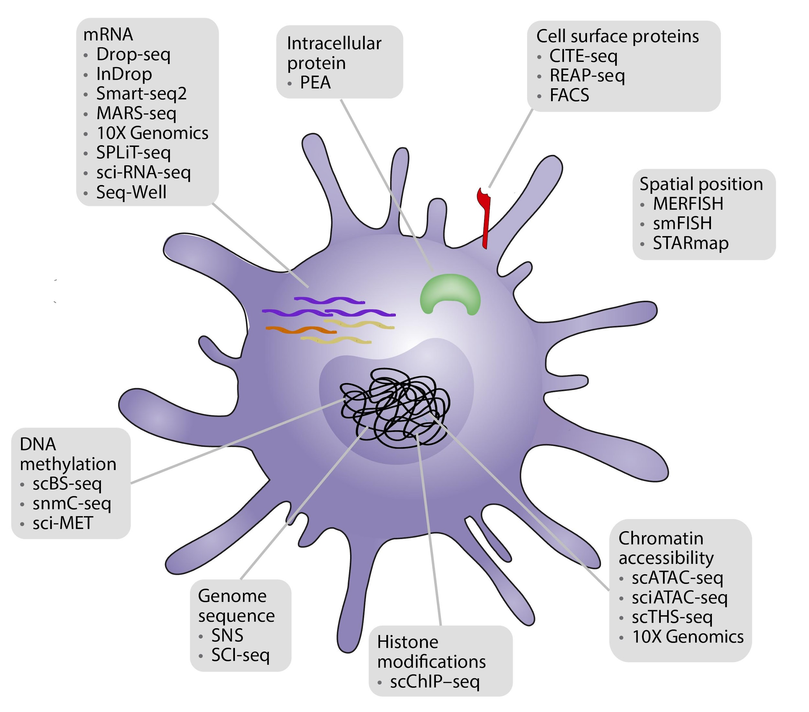
Single-cell genomics allows for the profiling of cellular and molecular diversity
Adapted from: Stuart et al. (2019). Nature Reviews Genetics
Notes:
Comprehensively profiling the molecular processes of cells can help us define healthy and diseased behaviors. While several methods have been developed to characterize different aspects of single cells such as cell surface proteins with FACS or chromatin with CHIP-seq, there has been a significant focus on mRNA since it is relatively easy to capture and can be used to explore everything a cell aspires to do at a given moment.
Analyzing the transcriptome can reveal important information about the genome, giving insight into cell types and states. In turn, characterizing distinct cell types can elucidate cell populations and cell-cell interactions that may play important roles in development or disease. As a result, several methods of single-cell RNA-sequencing have been developed to profile cells, each with its specific focus, strengths and weaknesses.
Samira

Slide 8
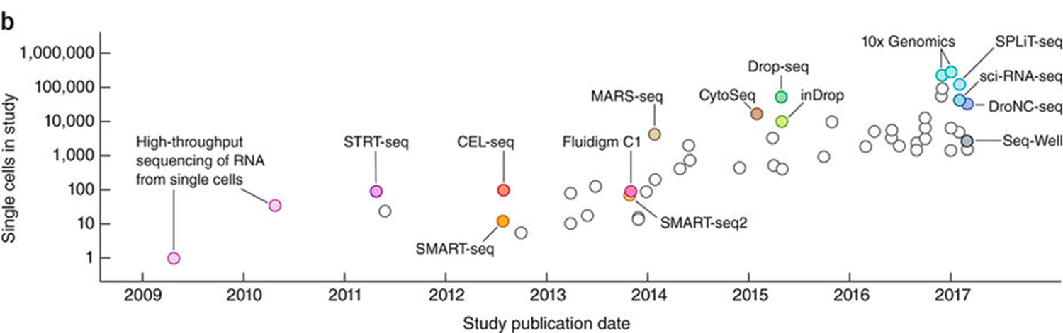
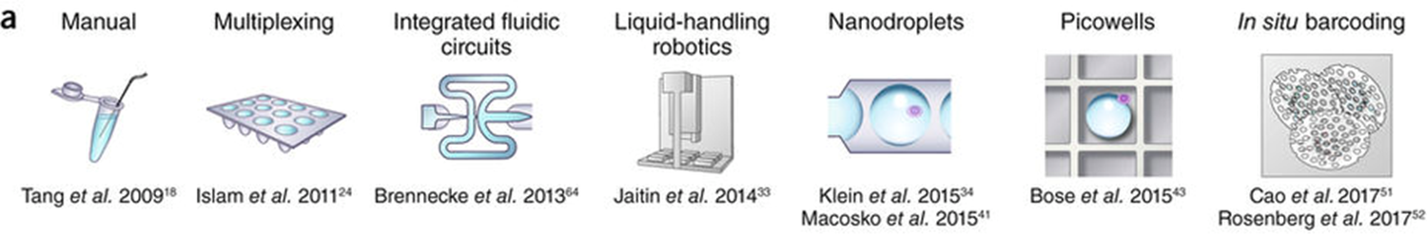
Single-cell RNA sequencing has grown exponentially
Single cells in study
Study publication data
Svensson V et al. (2018) Nature Protocols 13:599–604.
Notes:
Technology is rapidly evolving, and most mature single-cell genomics is scRNAseq. Growth here has been incredible.

Slide 9
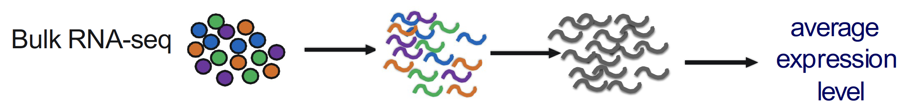
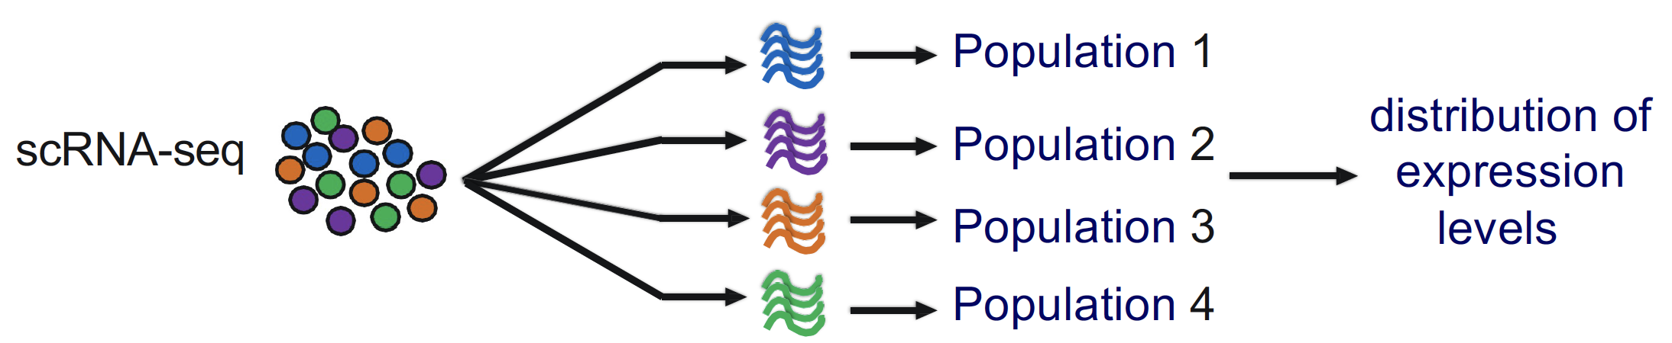
Bulk vs scRNA-seq
quantifying expression signatures from cell mixture
insufficient for studying heterogeneous system
Uncover regulatory relationships between genes and track trajectories
Understand cell-to-cell interactions
More precise understanding of the transcriptome/heterogeneity
Identify cell fates/map developmental trajectories
Figures from: https://www.biostat.wisc.edu/bmi776/lectures/scRNA-seq-analysis.pdf
Notes:
Before the emergence of scRNA-seq technology, RNA was profiled using Bulk RNA sequencing, which provides an average expression profile of all the cells in the sample. However, single-cell RNA sequencing can break down the spectrum by enabling the dissection of gene expression at the single cell level.
Single-cell RNA sequencing can reveal complex and rare cell populations, uncover regulatory relationships between genes, and track the trajectories of distinct cell lineages in development.
It helps in studying the molecular dynamics of the different cell types during the development stages.
A more precise understanding of the transcriptome in individual cells will be essential for elucidating their role in cellular functions and understanding how gene expression can promote beneficial or harmful states. Heterogeneity is always present in the different types of cells, including the T-cells, stem cells, tumor cells, as well as embryonic cells.
It also helps in revealing the changes in cell fate as well as mapping the developmental trajectories. The scRNA-Seq enables analysis of the developmental trajectories of the hematopoietic SCs. It can even be applied to determine the transcriptional state of the different individual muscle stem cells as well as the primary myoblasts.

Slide 10
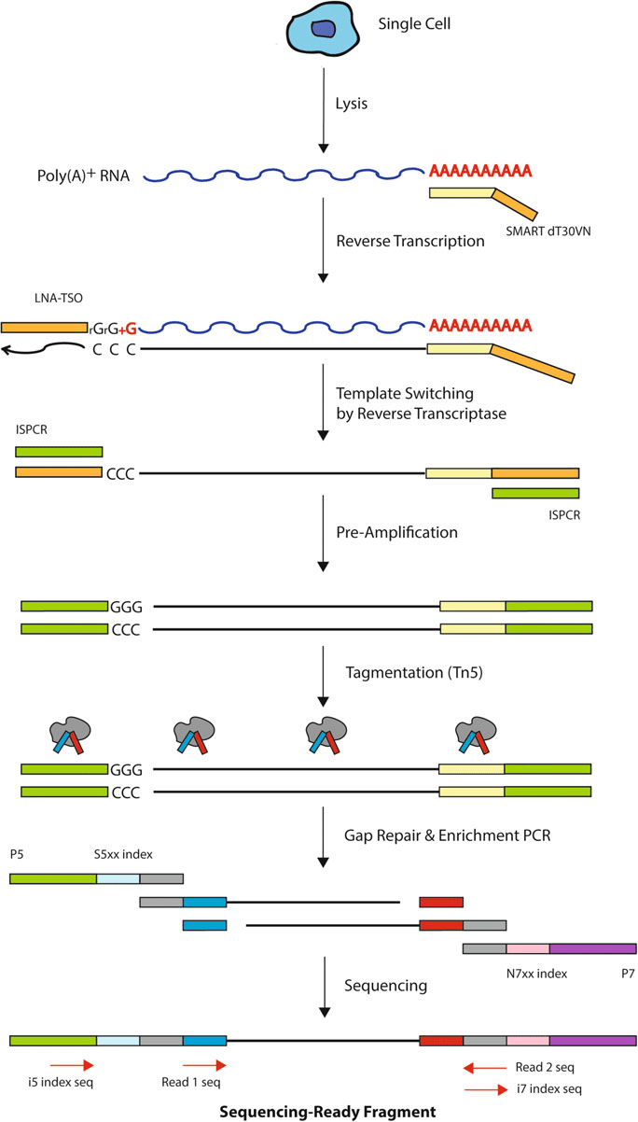
scRNA-seq is an important tool for identifying activation signals
Uncover regulatory relationships between genes and track trajectories
Understand cell-to-cell interactions
More precise understanding of the transcriptome/heterogeneity
Identify cell fates/map developmental trajectories
Notes:
Single-cell RNA sequencing can reveal complex and rare cell populations, uncover regulatory relationships between genes, and track the trajectories of distinct cell lineages in development.
It helps in studying the molecular dynamics of the different cell types during the development stages.
A more precise understanding of the transcriptome in individual cells will be essential for elucidating their role in cellular functions and understanding how gene expression can promote beneficial or harmful states. Heterogeneity is always present in the different types of cells, including the T-cells, stem cells, tumor cells, as well as embryonic cells.
It also helps in revealing the changes in cell fate as well as mapping the developmental trajectories. The scRNA-Seq enables analysis of the developmental trajectories of the hematopoietic SCs. It can even be applied to determine the transcriptional state of the different individual muscle stem cells as well as the primary myoblasts.

Slide 11
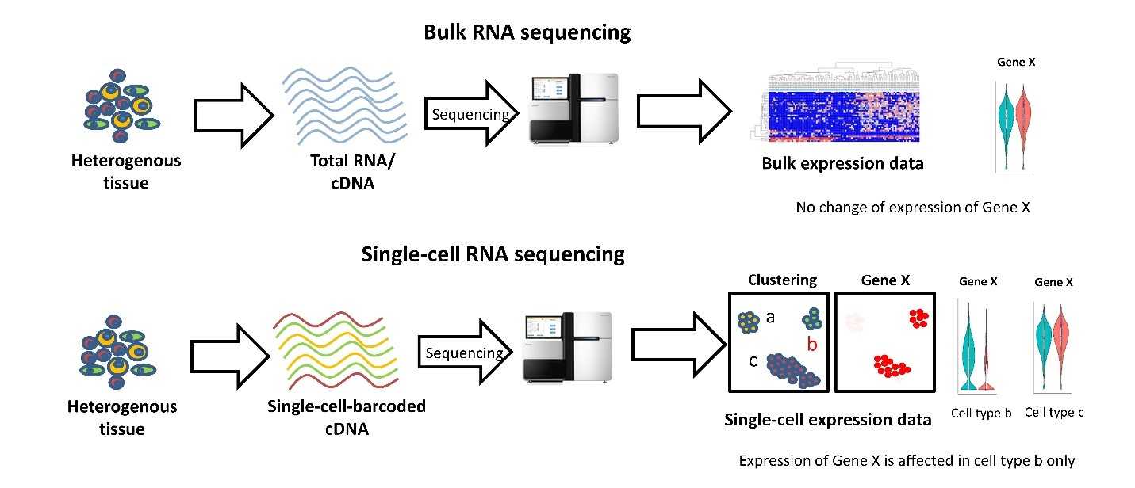
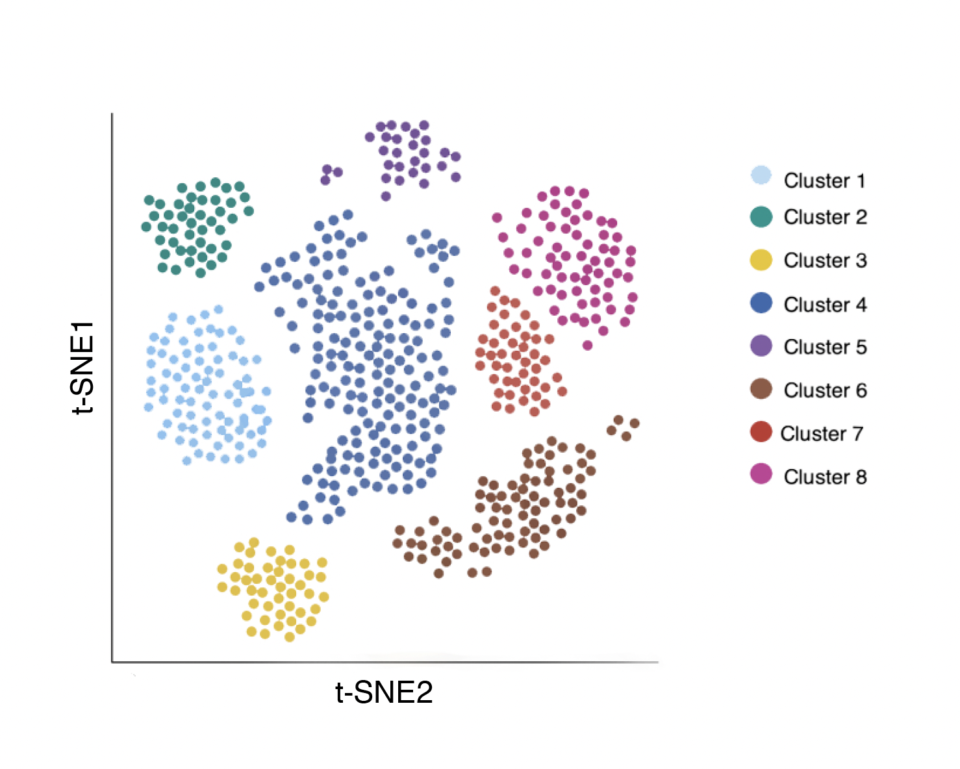
General scRNA-Seq Workflow
Data Analysis
﻿Velmeshev et al. (2019). Bulk RNA sequencing vs Single-cell RNA sequencing
Lafzi et al. (2018). Tutorial: guidelines for the experimental design of single-cell RNA sequencing studies, Nature Protocols
(https://doi.org/10.1038/s41596-018-0073-y)
Notes:
This is the general process for many high-throughput single cell RNA sequencing workflows. Beginning with some heterogeneous sample, we remove DNA, protein, and cellular debris in order to isolate mRNA. The mRNA is reverse transcribed and barcoded resulting in a cDNA library. The prepared library is sequenced, yielding millions of reads(or genes) which need to be mapped to a reference genome. The final result is an expression matrix of cells and genes that can be further analyzed. The main point of difference for many of the high-throughput methods is how the barcoded library is generated.
Samira
_______________

Slide 12
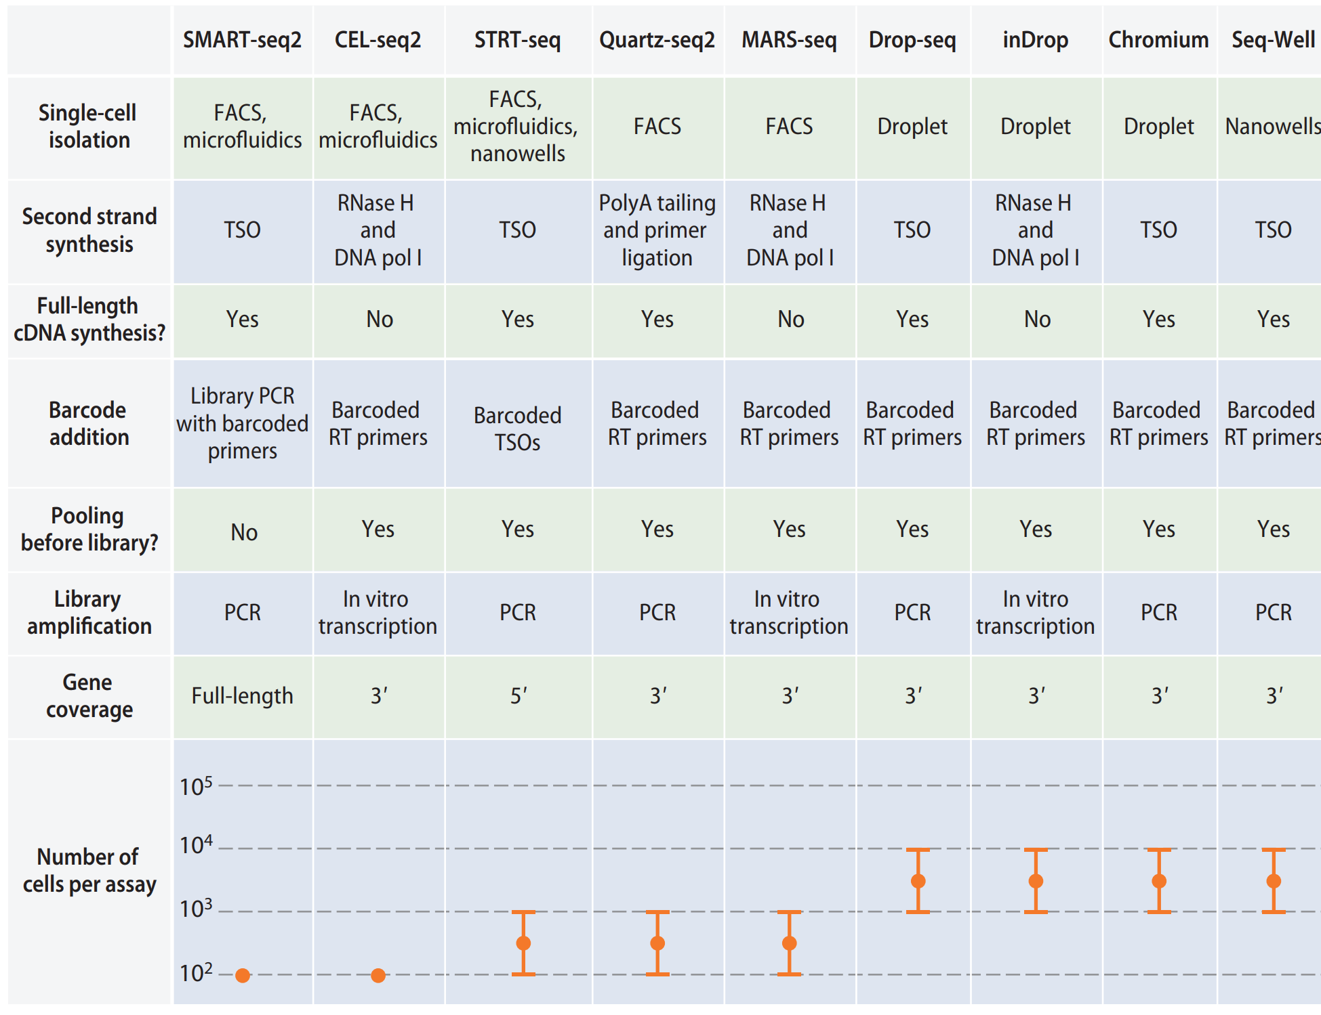
There are many single-cell RNA sequencing methods
Chen X. et al. (2018) Annual Review of Biomedical Data Science Vol. 1:29-51

Slide 13
Different methods can be categorized based on isolation
Chen X. et al. (2018) Annual Review of Biomedical Data Science Vol. 1:29-51

Slide 14
Only plate-based methods offer full-length gene coverage
Chen X. et al. (2018) Annual Review of Biomedical Data Science Vol. 1:29-51

Slide 15
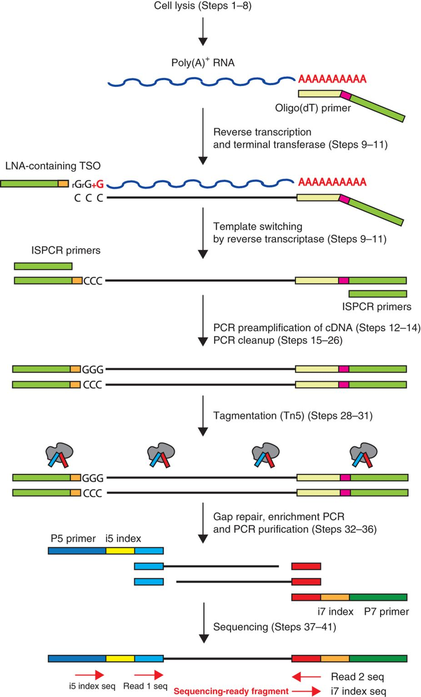
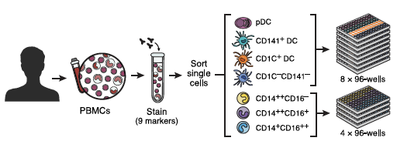
Single cell transcriptomics using SMART-Seq2
FACS sorting on 96/384-well plates
Plate based
~80% capture efficiency
Strengths:
Good cell capture
Full-length transcript
Weaknesses:
Expensive: ~$1 per cell
Picelli S. et al. (2014) Nature Protocols. 9, 171-181.
Villani A. et al. (2017) Science. 356(283), 1-12.
Notes:
Full transcript assay.
Uses template switching for 5' end capture.
labor intensive, slow, and costly
100s – 1000s of cells

Slide 16
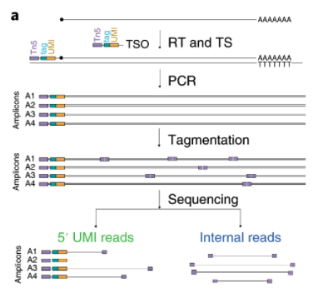
SMART-Seq2 + SMART-Seq3
SMART-Seq3
Picelli S. et al. (2014) Nature Protocols. 9, 171-181 https://doi.org/10.1038/nmeth.2639
Hagemann-Jensen et al. (2020) Nature Biotechnology. 38, 708–714
https://doi.org/10.1038/s41587-020-0497-0
Notes:
Reverse transcription
Cells are lysed in a solution that contains free dNTPs and tailed oligo-dT oligonucleotides (30-nt poly-dT stretch and a 25-nt universal 5′ anchor sequence) that are responsible for the priming of the RT reaction on polyadenylated RNA sequences.
The free dNTPs are added in the initial step to improve the yield of RT-PCRs (probably through mechanisms that stabilize RNA-primer hybridizations)
Template switching using an oligo with locked nucleic acid (LNA)¹¹ guanylate at the TSO 3′ end (rGrG+G)
SS3 uses a template-switching oligo (TSO) consisting of a partial Tn5 motif but that additionally has novel 11-bp tag sequence, followed by an 8-bp UMI sequence and three riboguanosines, the latter hybridizing to the non-templated nucleotide overhang at the end of the single-stranded cDNA

Slide 17
SMART-Seq2 + SMART-Seq3
SMART-Seq3
Picelli S. et al. (2014) Nature Protocols. 9, 171-181 https://doi.org/10.1038/nmeth.2639
Hagemann-Jensen et al. (2020) Nature Biotechnology. 38, 708–714
https://doi.org/10.1038/s41587-020-0497-0
Notes:
full cDNA amplification using PCR

Slide 18
SMART-Seq2 + SMART-Seq3
SMART-Seq3
Picelli S. et al. (2014) Nature Protocols. 9, 171-181 https://doi.org/10.1038/nmeth.2639
Hagemann-Jensen et al. (2020) Nature Biotechnology. 38, 708–714
https://doi.org/10.1038/s41587-020-0497-0
Notes:
SS2 uses a Tn5 transposase that catalyzes in vitro integration of predetermined oligonucleotides into target DNA

Slide 19
SMART-Seq2 + SMART-Seq3
SMART-Seq3
Picelli S. et al. (2014) Nature Protocols. 9, 171-181 https://doi.org/10.1038/nmeth.2639
Hagemann-Jensen et al. (2020) Nature Biotechnology. 38, 708–714
https://doi.org/10.1038/s41587-020-0497-0

Slide 20
SMART-Seq2 + SMART-Seq3
SMART-Seq3
Picelli S. et al. (2014) Nature Protocols. 9, 171-181 https://doi.org/10.1038/nmeth.2639
Hagemann-Jensen et al. (2020) Nature Biotechnology. 38, 708–714
https://doi.org/10.1038/s41587-020-0497-0

Slide 21
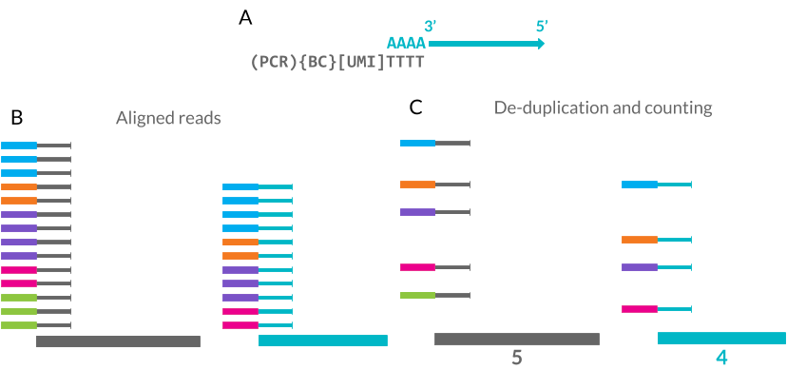
Unique Molecular Identifiers (UMIs)
UMIs are short (4-10bp) random barcodes added to transcripts during reverse-transcription
Figure from: https://lazappi.github.io/phd-thesis/1-introduction.html
Notes:
They enable sequencing reads to be assigned to individual transcript molecules and thus the removal of amplification noise and biases from scRNA-Seq data
complex indices added to sequencing libraries before any PCR amplification steps, enabling the accurate bioinformatic identification of PCR duplicates
They reduce the amplification noise by allowing (almost) complete deduplication of fragments

Slide 22
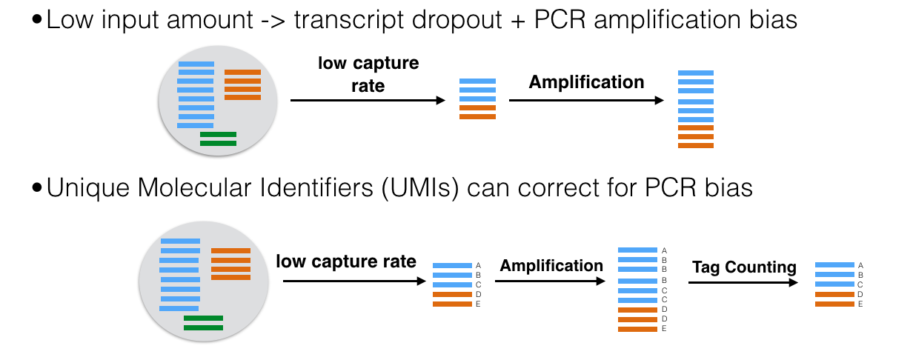
UMI : Unique Molecular Identifiers (Random Molecular Tags)
Early labeling of mRNA molecules with random nucleotide tags enables amplification biases to be corrected
Remember : UMIs do not correct for low-capture rates, which leads to an abundance of false negatives. Capture rates are estimated to 5-20% across various protocols
Slide courtesy of Karthik Shekhar and Orr Ashenberg

Slide 23
Droplet isolation allows for higher throughput
Chen X. et al. (2018) Annual Review of Biomedical Data Science Vol. 1:29-51

Slide 24
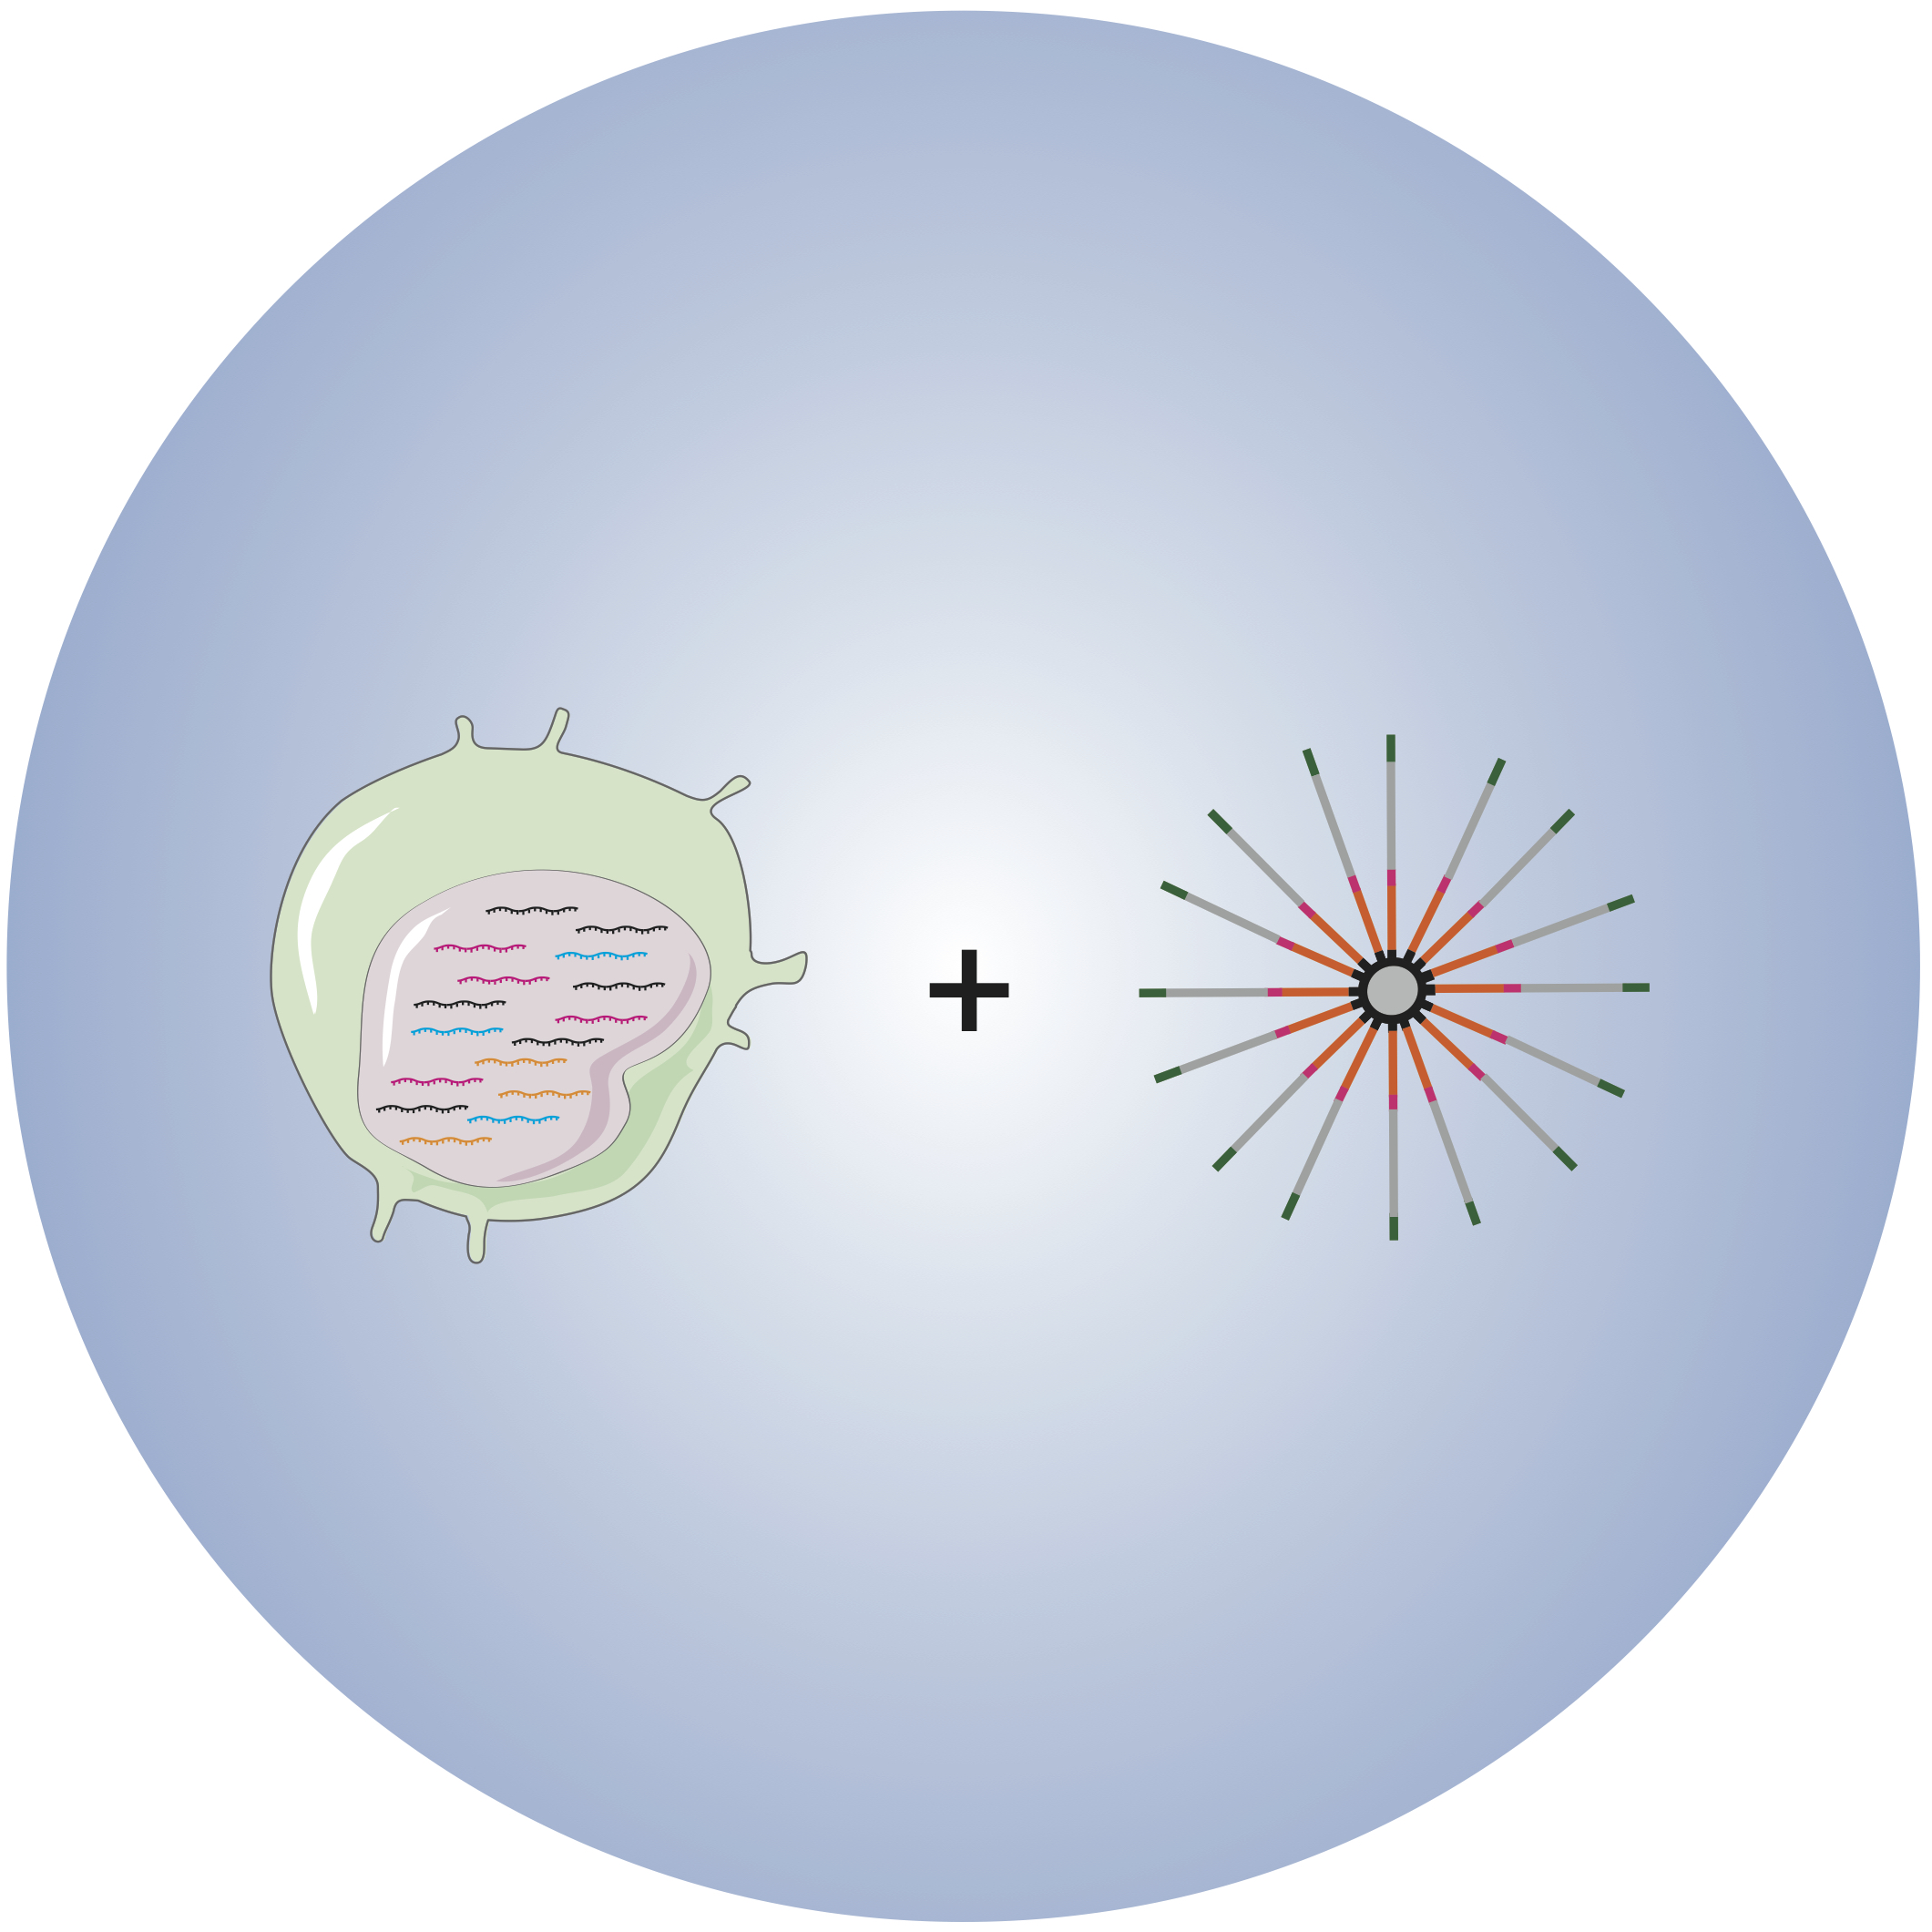
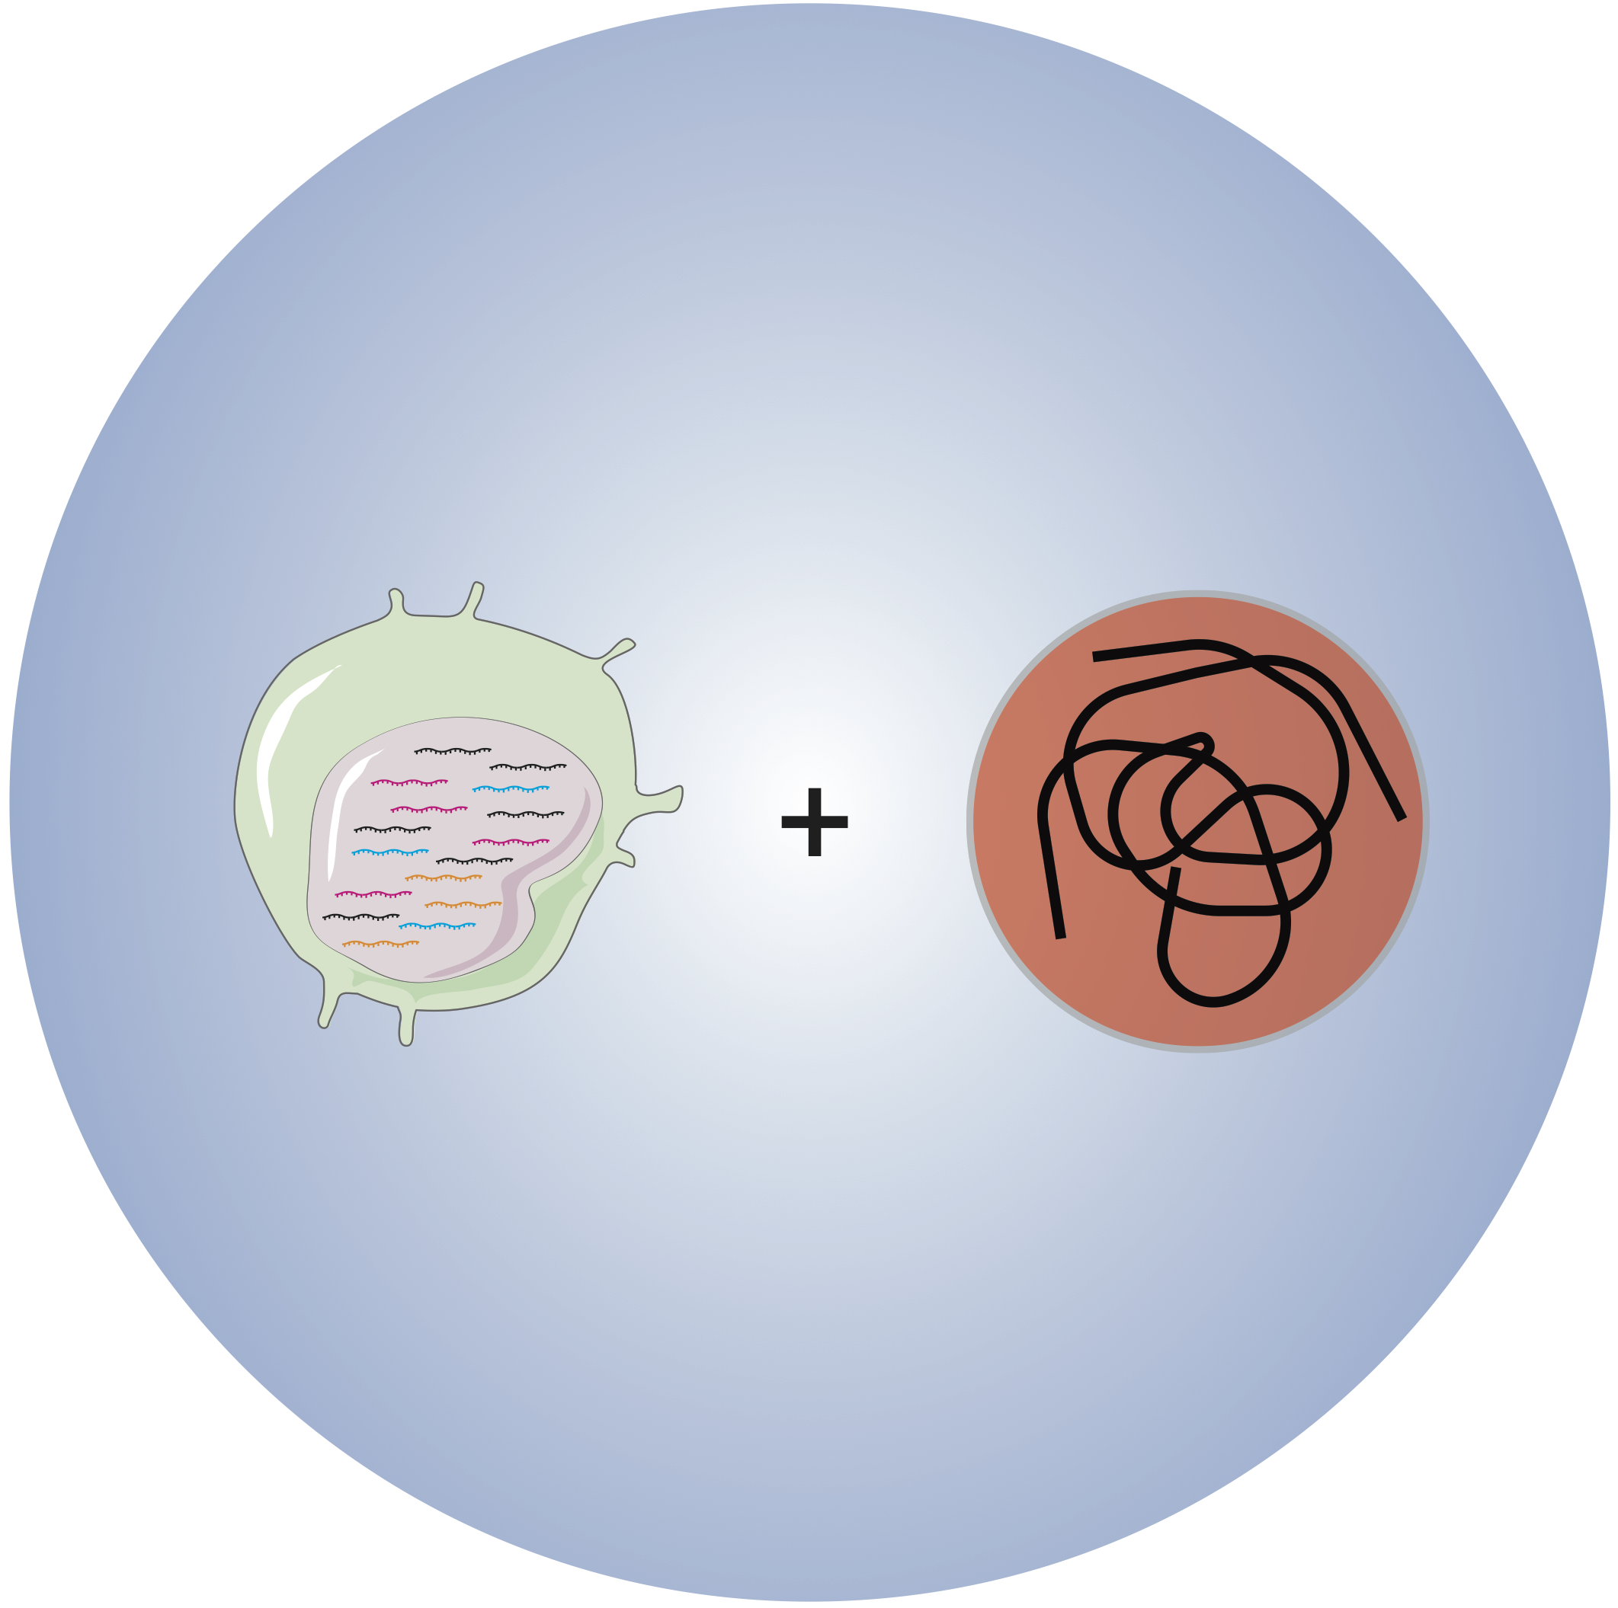
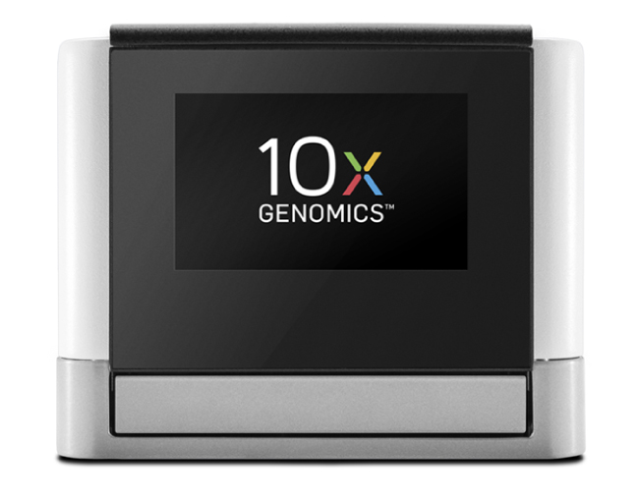
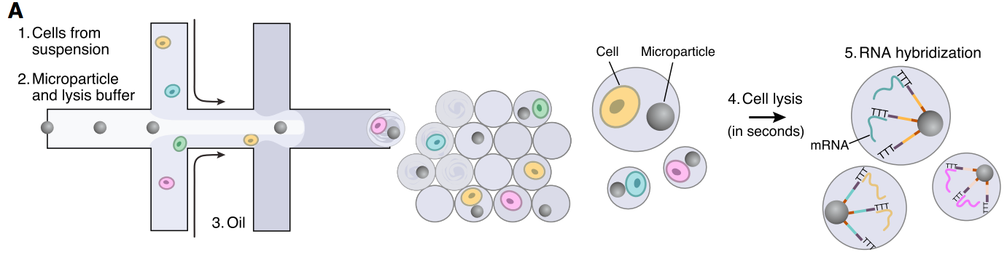
Drop-Seq
inDrop
10X Chromium
Klein et al, Cell, 161 (2015)
Macosko et al, Cell, 161 (2015)
Notes:
Many of the current high-throughput single-cell RNA-sequencing methods are droplet-based.
For example, Drop-Seq uses a microfluidic device. Individual cells and microparticles responsible for delivering barcoded primers are loaded at a low density, and are randomly encapsulated in a droplet such that some number of droplets will contain both one cell and one bead. After lysis and hybridization, you obtain a set of beads called “single-cell transcriptomes attached to microparticles” or STAMPs. These STAMPs can be subsequently reverse transcribed, amplified and pooled for sequencing. In Drop expands on the technology used in Drop-Seq but instead uses hydrogel beads, and 10X Chromium uses gel-like beads containing barcodes that can dissolve in the droplet. While all three workflows generate droplets that can accommodate single-cell reactions and ascribe information to the cell using barcoded beads, there are important considerations to think about for each method.
*Drop-Seq uses double Poisson distribution
*10X is reported to have ∼80% bead occupancy and a cell capture rate of ∼50%

Slide 25

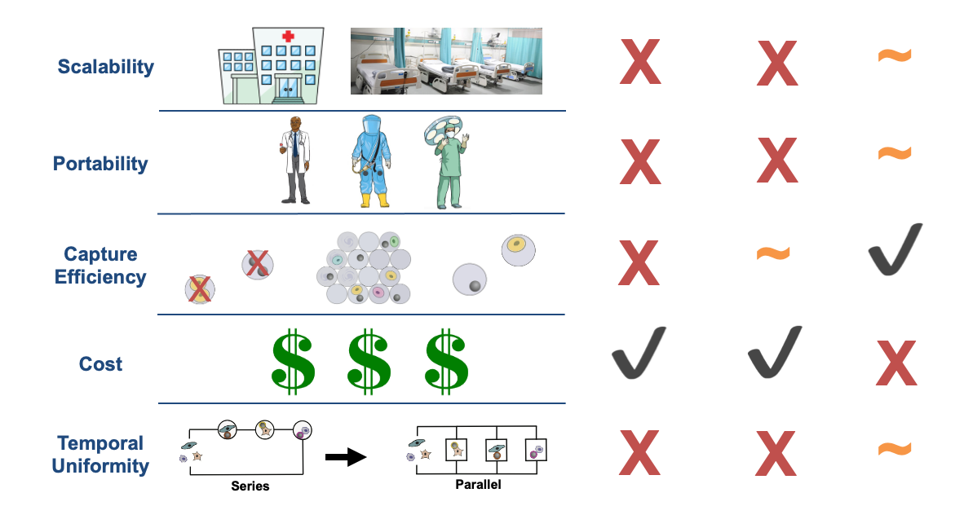
Drop-seq Methods Have Clinical Complications
Notes:
Sarah
Each of these high-throughput methods has its own strengths and advantages. However, as discussed before, these droplet based techniques also present some clinical complications such as the loading density.
-> The most obvious one is the LOW CAPTURE EFFICIENCY of Drop-Seq! With the result of the emulsion happening , you’ll end up with lots of droplets. But the problem is Most of these droplets will contain nothing! Very few droplets will have one bead and one cell! And the reason for this is because cells and beads randomly get encapsulated into those droplets.
-> Another common issue in terms of scalability occurs in the case you have for example a fresh sample such as cancer biopsy, and you don’t want to waste cells, so methods such as Drop seq or indrop are not going to be ideal due to their low capture efficiency
-> On the other hand, we have 10x which scales pretty well and has better capture efficiency. But the problem with 10x is as we get up into more samples, as it scales up, the reagent cost tends to become too expensive and this is not ideal for a person who’s more implemented.
Thus, the goal here was to create a more cost effective method but which also has a better capture efficiency.

Slide 26
Different methods can be categorized based on isolation
Chen X. et al. (2018) Annual Review of Biomedical Data Science Vol. 1:29-51

Slide 27
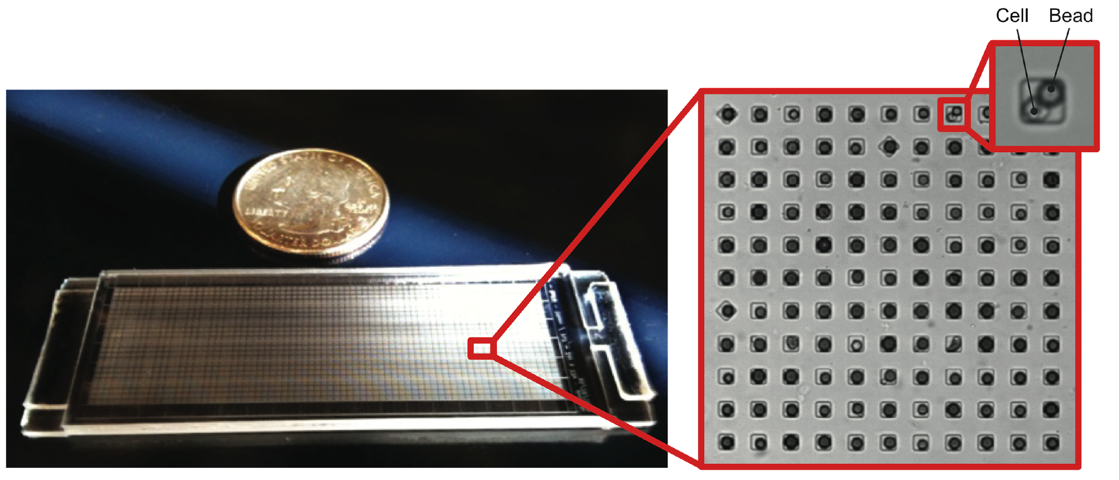
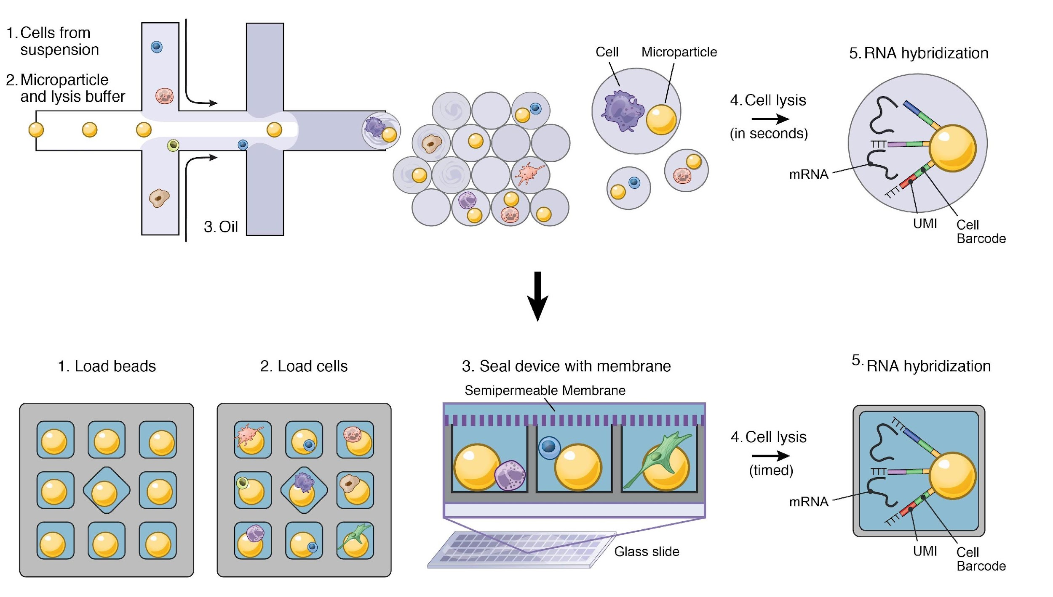
A Solution: Seq-Well
Seq-Well
Notes:
Due to the low efficiency in encapsulation observed in the droplet based techniques, rather than trying to capture cells or barcoding beads using droplets, one of the alternatives that has been made by Seq Well is to use an array that already has a set of these little boxes which are compartments for the beads and cells.
This enables us to do something simply with gravity which makes it more efficient and easier to implement. These little boxes, known as subnanoliter wells, accommodate only one bead which allows single bead loading efficiencies of ~95%. Cells are loaded by gravity into wells containing beads enabling a capture efficiency of ~80%.
Also, one of the huge advantages of performing Seq Well as opposed to other techniques is its portability. With only an array, a pipette, a manual clamp, an oven and a tube rotator, this new technology can be performed almost anywhere.

Slide 28
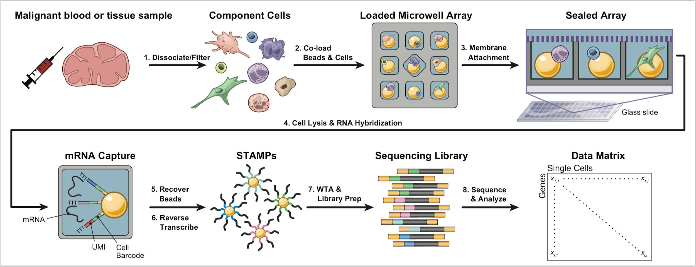
Seq-Well: Massively Parallel Single-Cell RNA Sequencing
Gierahn, et al. Nat. Methods, (2017)
Notes:
Overview of Seq Well
At a high level, some of these steps are similar to other scRNA Seq protocols but here we’ll be touching down on the key steps that make this methodology unique.
With Seq-Well, cells are extracted and dissociated from a malignant blood or tissue sample using its respective protocols. Now, instead of loading the beads and the cells onto the 10 x device, cells and beads are loaded on one of these microwell arrays that we functionalize. Wells accommodate only one bead and one cell which increases the single bead loading efficiencies as well as the capture efficiency for cells. The array is then sealed using chemical functionalization of the semi permeable polycarbonate membrane. This is one of the key features of Seq well; it allows cell lysis and facilitates buffers to be exchanged freely while blocking other biological macromolecules ->> This indeed improves transcript capture and reduces cross contamination. After the single cells have been lysed, we’ll have a bead-bound poly (dT) oligonucleotide that will contain a universal primer sequence, a cell barcode and a unique molecular Identifier (UMI), this will help capturing cellular mRNAs. Next, the membrane is peeled off and the beads are removed for subsequent bulk reverse transcription, amplification, library preparation and paired end sequencing. In this presentation, we will elaborate on the protocol steps unique to seq-well.
Membrane pore size: 0.01micron
Capture is mostly kinetics, getting the beads on takes time

Slide 29
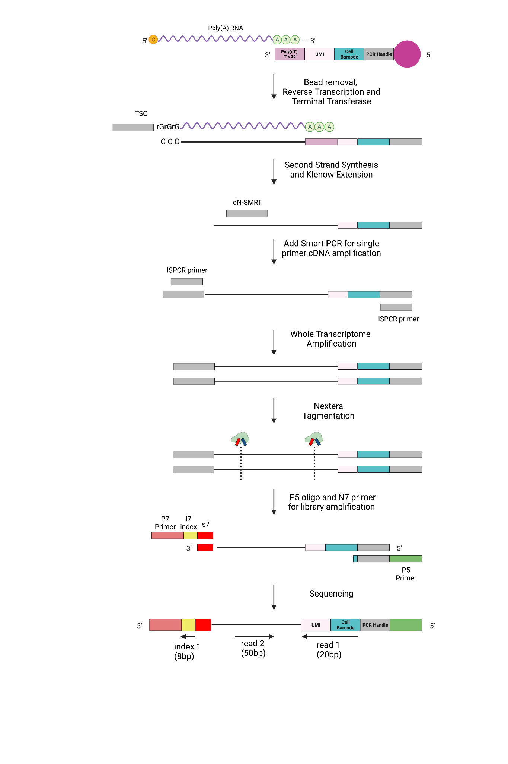
Downstream Steps
RT and Exo digestion
Second Strand Synthesis
WTA (PCR)
Library Prep
NGS and Analysis
Notes:
Once the beads with the hybridized mRNA have been isolated in eppendorf tubes, we perform the standard reverse transcription to generate the full length of cDNA. This is done by incubating the reverse transcription mixture which includes a template switching oligo (TSO) used as a universal priming site for PCR amplification at the 3’ end. Thus, this will hybridize to the 5’-untemplated C-bases (added by terminal transferase) for full-length cDNA synthesis and amplification.
Sarah

Slide 30
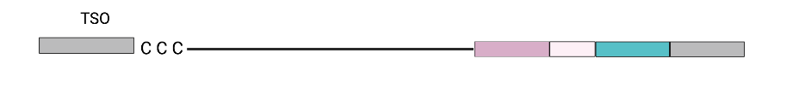
Downstream Steps
RT and Exo digestion
Second Strand Synthesis
WTA (PCR)
Library Prep
NGS and Analysis
Exonuclease I Digestion
Notes:
In order to remove excess primer, we then subject the cDNA to an exonuclease treatment

Slide 31
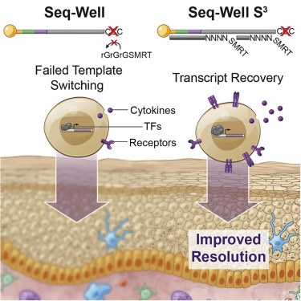
Downstream Steps
RT and Exo digestion
Second Strand Synthesis
WTA (PCR)
Library Prep
NGS and Analysis
cDNA
Notes:
During RT, sometimes we don’t get this template switching which is essential for the amplification of cDNA. In these cases, the absence of the trailing C’s prevents TSO from binding to the cDNA and consequently, the PCR primer does not reverse transcribe onto the cDNA necessary from PCR amplification and you lose a lot of transcripts.
Thus to improve transcript recovery, seq-well adds an additional step called second strand synthesis which incorporates a randomer primer, dN-SMRT, which will bind to parts of the cDNA to recover transcripts lost during inefficient template switching, as shown in the figure in the right.
To do that, we basically perform denaturation by washing the barcoded mRNA beads with 0.1M NaOH which will remove the attached RNA template. Then with the help of the klenow enzyme labeled with SMART sequence, there will be primers that will let us make this first length cDNA but will also come down and bind to its reverse complement to make sure that things that are double stranded are going to be amplified. only one strand is shown here

Slide 32
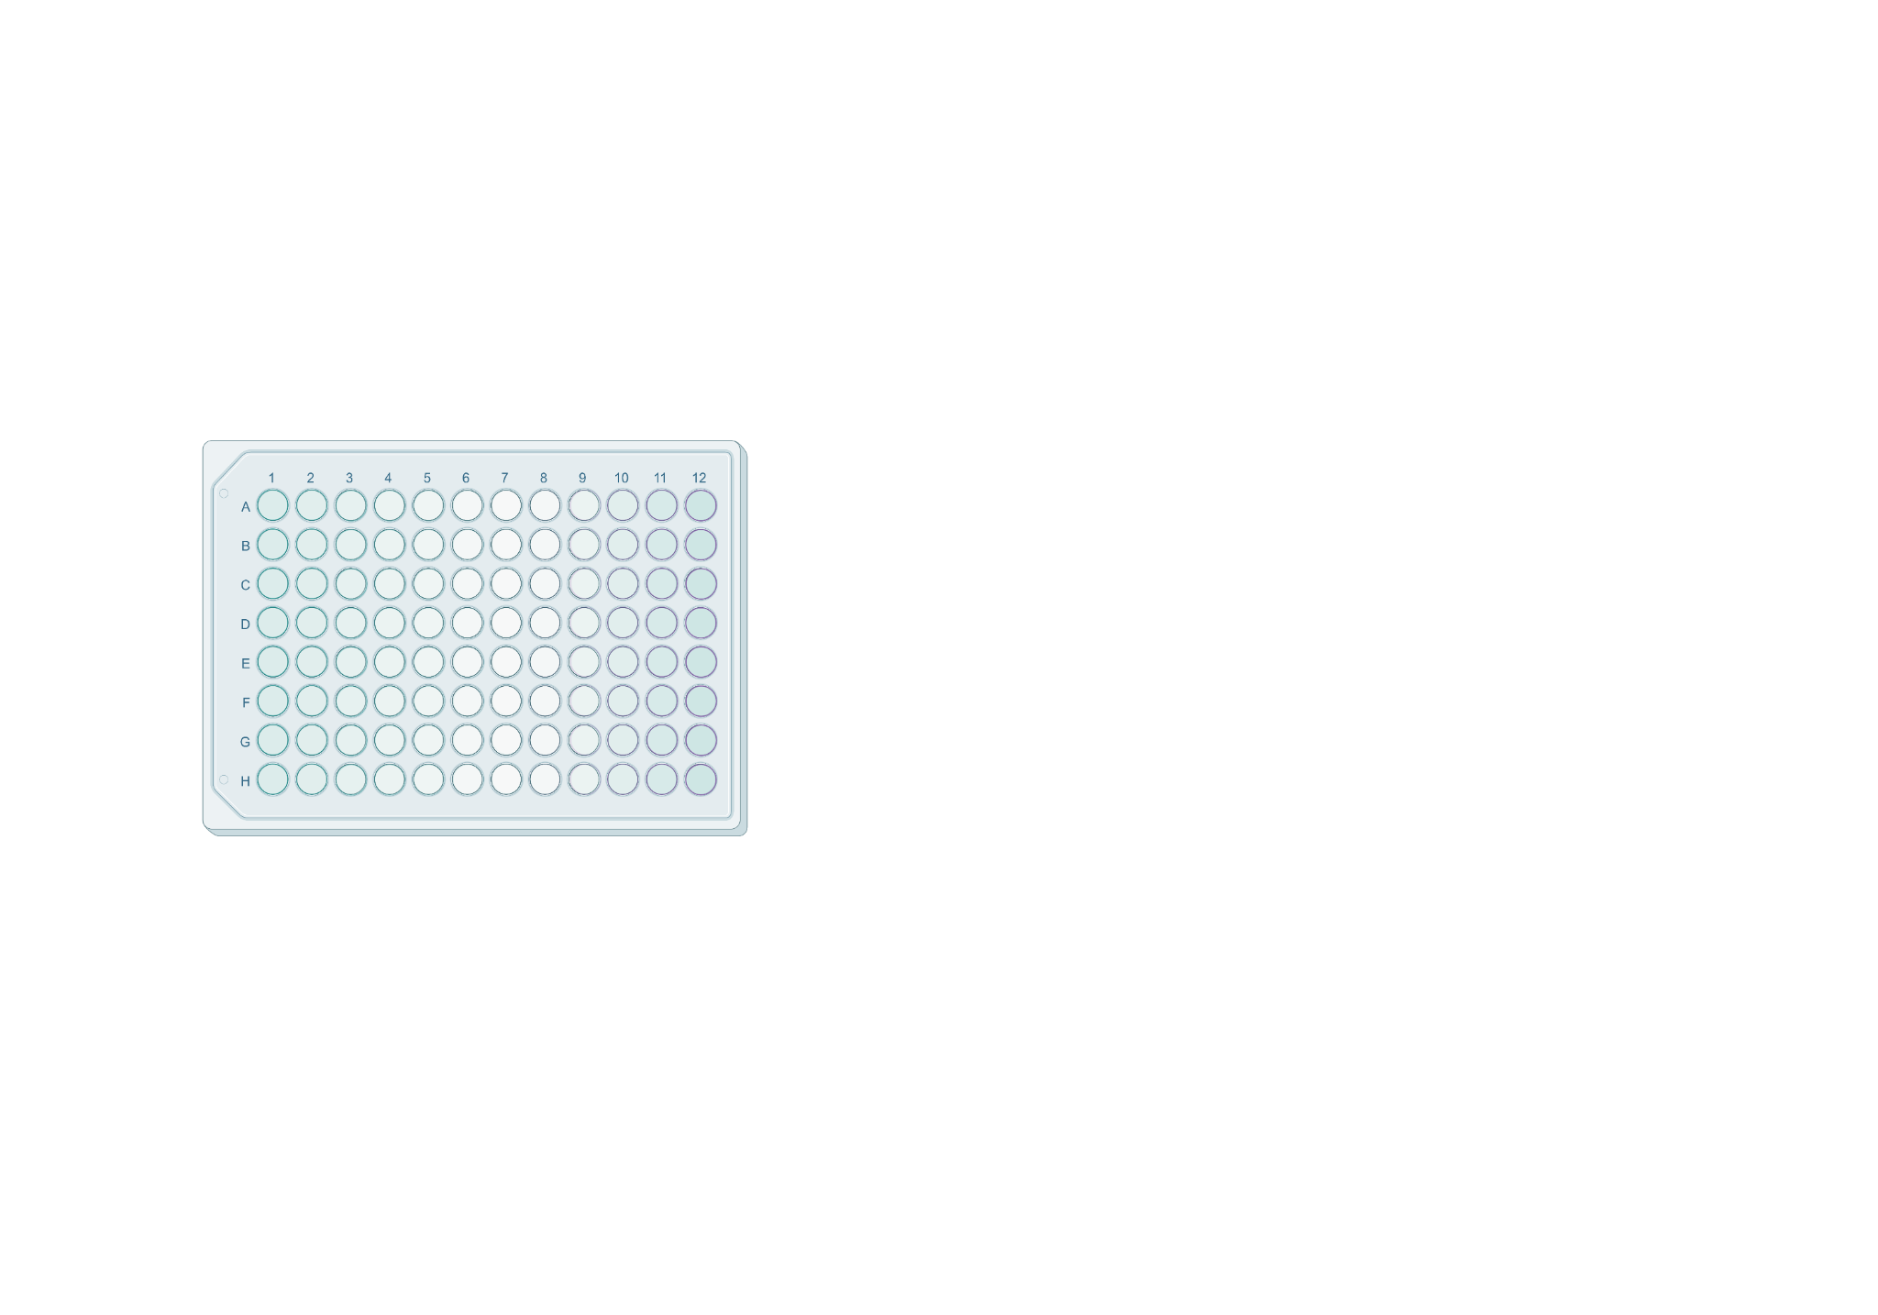
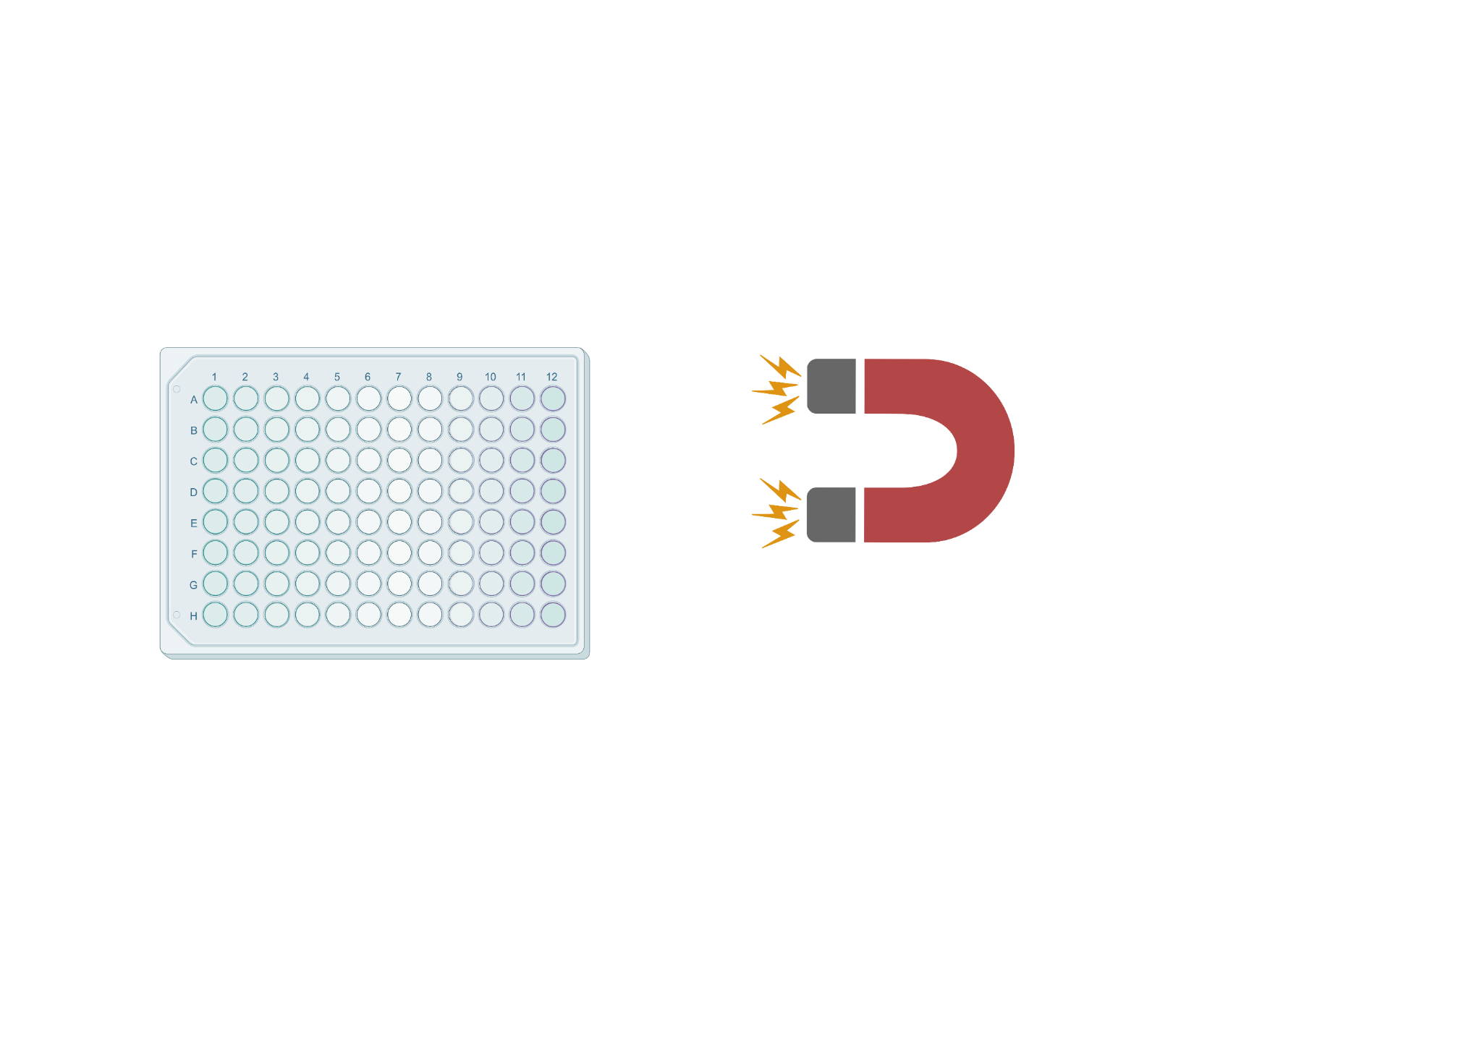


Downstream Steps
RT and Exo digestion
Second Strand Synthesis
WTA (PCR)
Library Prep
NGS and Analysis
Magnetic SPRI Extraction
RNA
DNA
Debris
Notes:
Tasneem
Once we have our double stranded DNA with the universal primer sequence for amplification, we amplify the cDNA product using the ISPCR primer for whole transcriptome amplification. The number of PCR cycles can vary based on the sample type. Once amplified, we isolate our WTA product through 2 rounds of SPRI purification using Ampure Spri at 0.6x and 0.8x volumetric ratio respectively. We then quantify our product using Qubit to measure concentration before prepping the sequencing library

Slide 33
Downstream Steps
RT and Exo digestion
Second Strand Synthesis
WTA (PCR)
Library Prep
NGS and Analysis
Notes:
Tasneem
The WTA product is then tagged randomly with the Nextera barcodes. During tagmentation, the DNA gets cleaved into random fragments, however, only the 3’ end of cDNA fragment with a s7 sequence, a universal illumina adapter, will be amplifiable and used for library prep and sequencing. The P7 primer anneals to the 3’ end and a P5 primer anneals to the 5’ end of the cDNA. The transposase adds these adapters randomly which are essential for illumina sequencing, usually half of the library will get amplified.

Slide 34

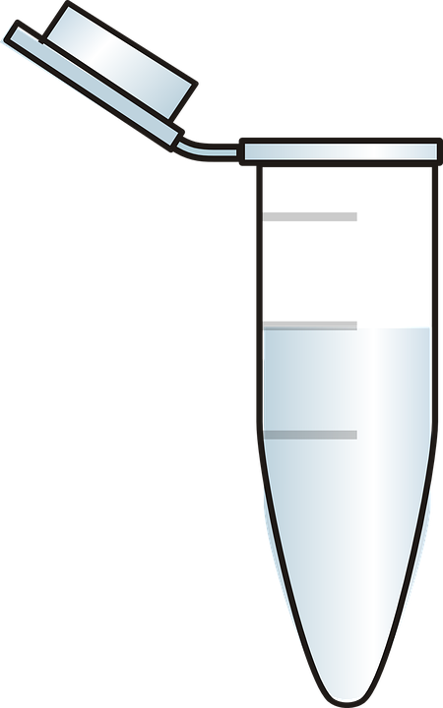
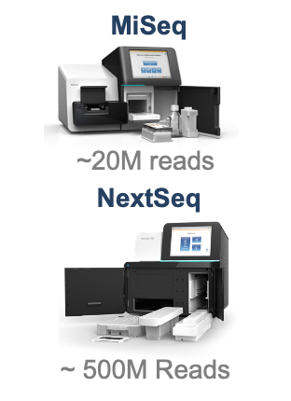
Downstream Steps
RT and Exo digestion
Second Strand Synthesis
WTA (PCR)
Library Prep
NGS and Analysis
Pooled cDNA Library
Data Analysis
Notes:
Tasneem
The final library product is then cleaned via magnetic spri extraction, pooled and quality controlled before being sequenced. Read 1 corresponds to the cell barcode and UMI, index 1 corresponds the well specific barcode to keep track of the samples and read 2 corresponds to the genes of interest. The samples can then be sequenced on a miseq, nextseq or novaseq, each which produce different number of reads. the data is then demultiplexed and aligned to produce a matrix where the rows are genes and columns are cells. This data can then be quality controlled and analyzed, here we show a TSNE plot, a common analysis tool for scRNA seq data.

Slide 35
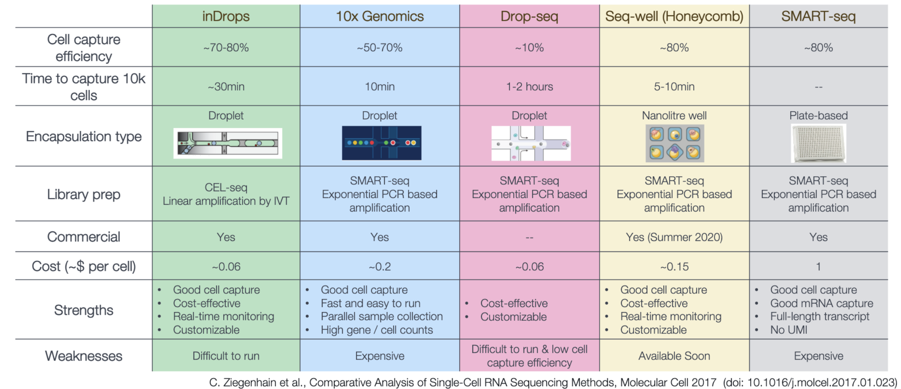
There are many single-cell RNA sequencing methods
Each protocol has advantages and limitations. What one ends up using is often dictated by multiple features - the biological context, cost, objective etc.

Slide 36
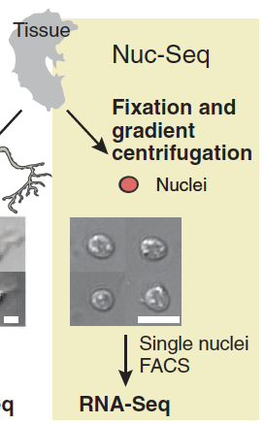
Considerations for single cell RNA-Seq
Choose protocol based on :
Throughput (# of cells / reaction )
Sample of origin
Cost / Labor / Time limitations
Gene body coverage - 5’, 3’ biased, or full-length?
UMI vs no-UMI
Sequencing depth / cell
For example :
If I want to classify all cell types in a diverse tissue (e.g. brain), I need high throughput
If I want to re-annotate the transcriptome and discover new isoforms, I need full-length coverage
If I only have access to archival human samples, I will need to use a method that permits fixed cells (or nuclei)
Slide modified from Karthik Shekhar and Orr Ashenberg
Habib N. et al. (2016) Science. 353, 925-928.
Notes:
# of cells: 10s, 100s, 1000s, 10s of 1000s
Sample: frozen/fresh
Cost/labour

